Slide 1
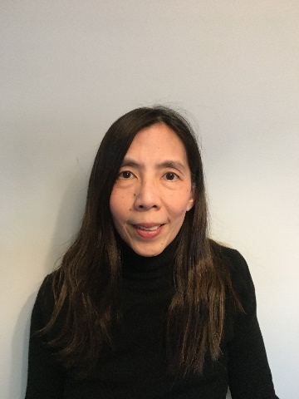
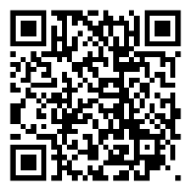
Jennifer Lee, MSEE
jl308@columbia.edu
212.851.9252
Office: 1312 Mudd
OFFICE HOURS (by appointment): https://calendly.com/jl308/advising
“I look forward to helping you navigate the job search process and launch successful careers!”

Slide 2
Career Checklist for New Students
☐ Join Columbia University EE Networking Group on LinkedIn https://www.linkedin.com/groups/4790690/
☐ Begin identifying your interests, values and skills
☐ Research employers & create a Target list of companies
☐ Start Networking! Reach out to SEAS alumni
☐ Work on your pitch
☐ Begin creating stories for your interviews
☐ Schedule an advising appointment to review resume/cover letter, discuss job search strategies, prepare for interviews, …

Slide 3
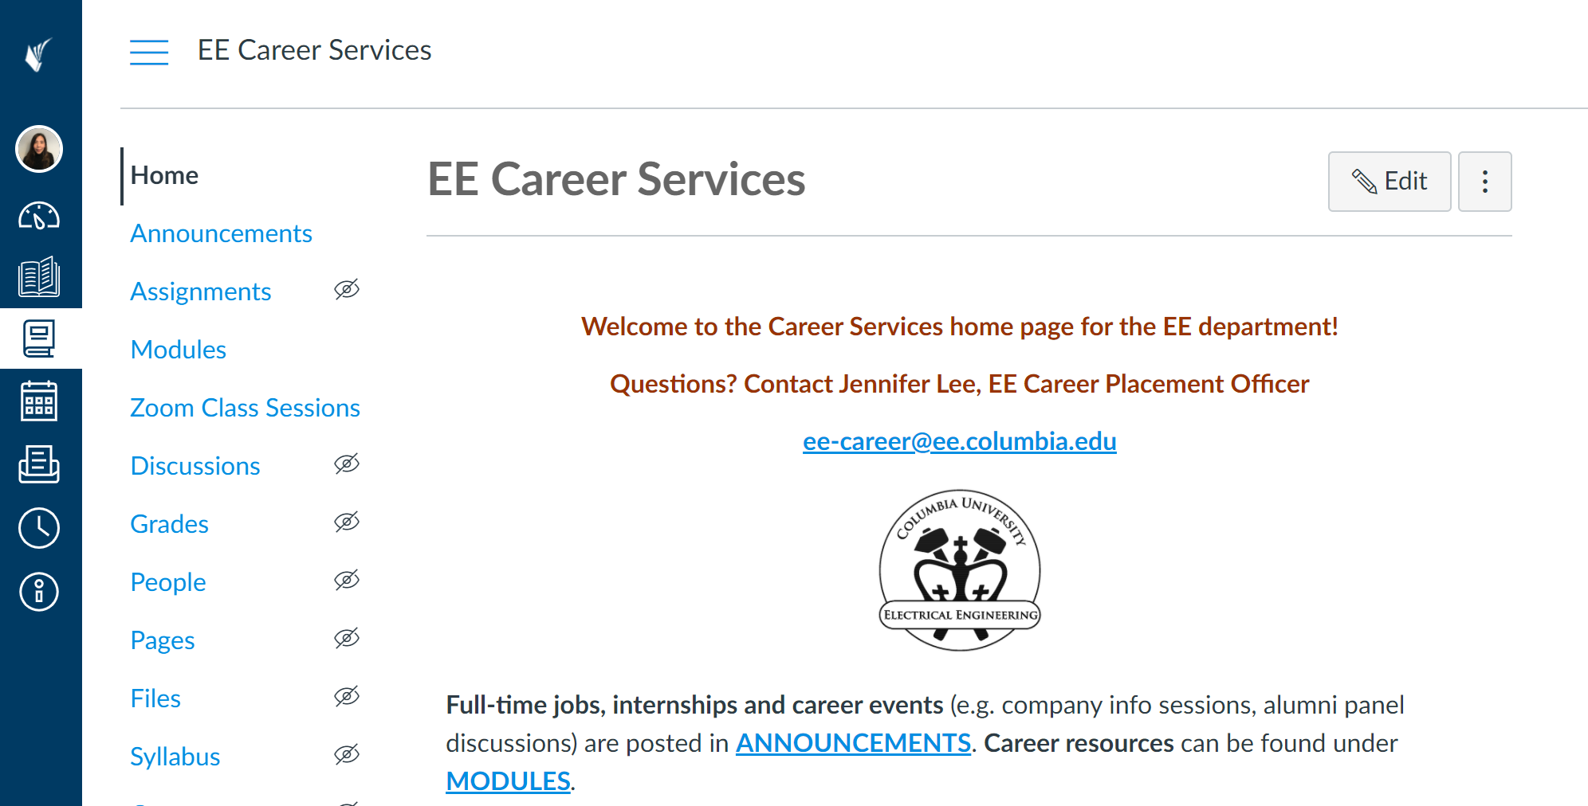
EE JOB BOARD/CAREER EVENTS (on Canvas)
https://courseworks2.columbia.edu/courses/111101

Slide 4
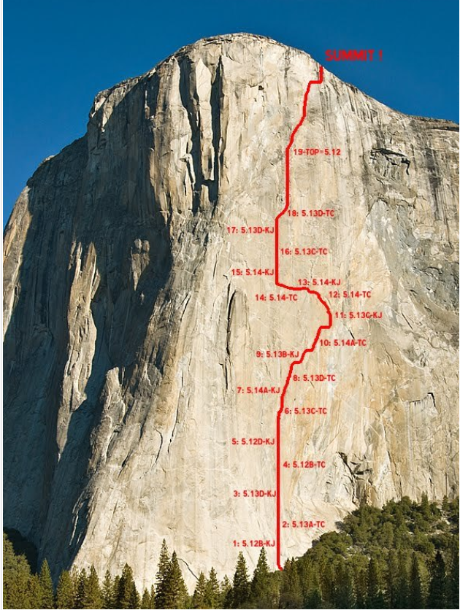
Career Goal
“There are many paths to the top of the
mountain but the view is always the same”

